Slide 1

The Innovation Lab
Summer Internship 2022
Mentor-Intern Meeting 1
VAAYUBHOOMI
Mentors: Shayak Bhadraray Harshith Kumar MB
T Vijay Prashant
Interns: Pramuk MP
Samuel Thomas
Sriram Radhakrishna

Slide 2
Problem Statement
Networked robots for reconnaissance over open environments
Localization of objects in known and unknown terrains
Recon based network autonomous system
USP: Communication between UAV and UGV
Helps overcome disadvantage of either system
<Project Name>

Slide 3

Proposed Approach
We intend to execute this project in two phases : Phase 1 is a simulation of the UAV and Phase 2 is an implementation of an autonomous system with the UGV.
Phase 1 UAV - Patrol bot that works in a specified area
Detects specific targets while on predetermined patrol path
Hones in on the same with a freshly generated path
After target acquisition by the sensors, path planning occurs along with transmission of the pose of the target to UGV. Location saved as a node.
Simulation occurs in ROS + Gazebo
Phase 2 UGV - Ground vehicle
Pose of the target acquired, path planned
Cameras and sensors integrated for autonomous capabilities
Potential Hardware aspects explored contingent on time
<Project Name>

Slide 4
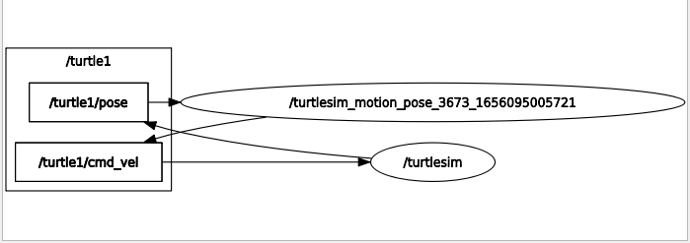
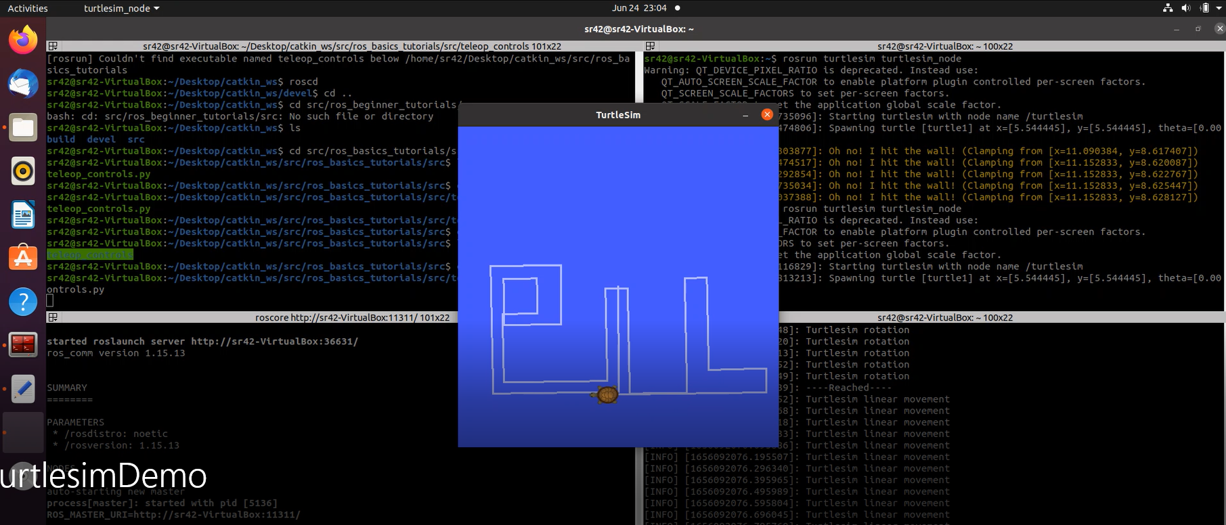
ROS Tutorial by Annis Koubaa on Udemy
Covers messages, topics, nodes,services, publishers and subscribers
Worked with Turtlesim as part of the course
Understood the framework of ROS and Catkin
Supplemented with an EdX course
Compiled nodes to send messages from publisher to subscriber.
Wrote publisher nodes and abstracted movement functions for turtlesim.
Worked with the rqt_graph to understand conceptualisation of pub & sub
Installed and set up our ROS packages and workspaces using the catkin build system.
Took a course on Git version control and set up a repository for the project.
Progress + Individual Contributions
<Project Name>

Slide 5
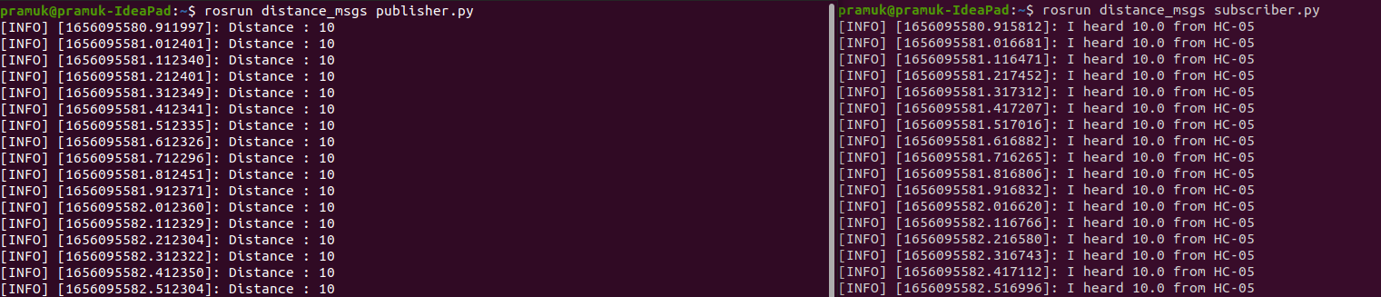
Custom Message Communication between Nodes

Slide 6
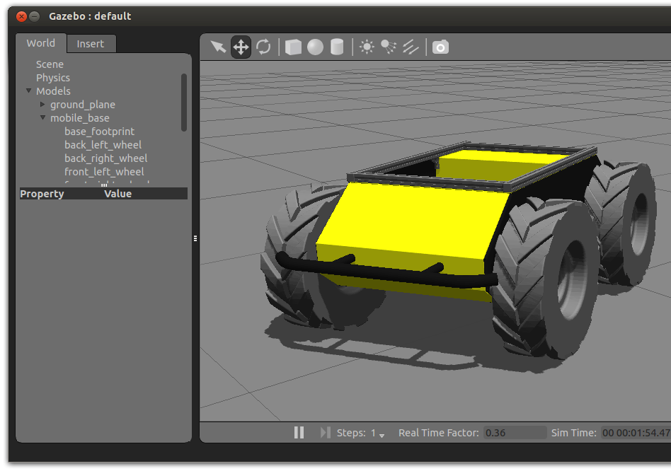
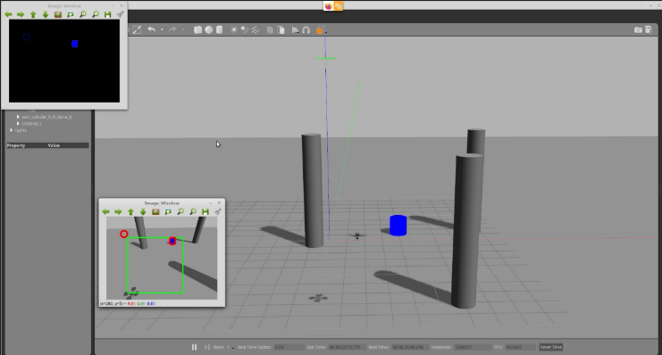
Plan for the next 2 weeks
Work on the Husky UGV - Husky is a rugged, outdoor-ready unmanned ground vehicle (UGV), suitable for research and rapid prototyping applications. To get started on simulating this bot ..
Develop an understand of ROS and gazebo
Acquire knowledge of interaction of Husky with environment
Hector Quadrotor package …
Phase 1 construction begins here
Simulation of the UAV
UAV localization algorithm
<Project Name>

Slide 7
Thank You

